Slide 1
SER 334 A Session
Exam 2 Review Session
February 8th 2024
7:00 pm - 9:00 pm MST

Slide 2
{
Agenda
Practice Exam
Sample Problems
Q&A

Slide 3
SI Session Expectations
Thanks for coming to the SER 334 SI session. We have a packed agenda and we are going to try to get through as many of our planned example problems as possible. This session will be recorded and shared with others.
If after this you want to see additional examples, please visit the drop-in tutoring center.
We will post the link in the chat now and at the end of the session.
tutoring.asu.edu
Please keep in mind we are recording this session and it will be made available for you to review 24-48 hours after this session concludes.
Finally, please be respectful to each other during the session.

Slide 4

Interact with us:
Zoom Features
Zoom Chat
Use the chat feature to interact with the presenter and respond to presenter’s questions.
Annotations are encouraged

Slide 5

Opens: Saturday February 10th
@ 2 AM
SER 334
Exam 2 Review
Exam Info Page
Front and Back!
Closes: Sunday February 11th
@ 11:59 PM
Practice Exam
75 minutes
Pro Tip: Take a peek at the programming questions before getting started
~26 questions

Slide 6
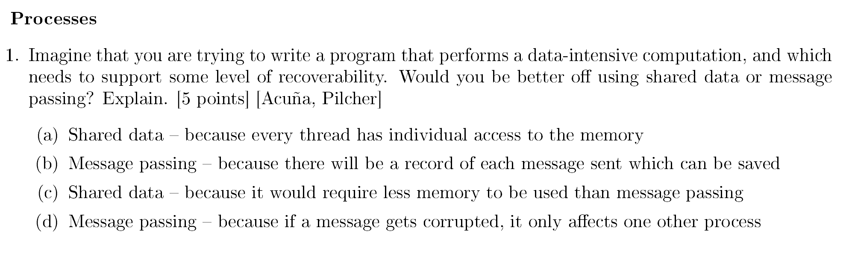
SER 334
Exam 2 Review

Slide 7
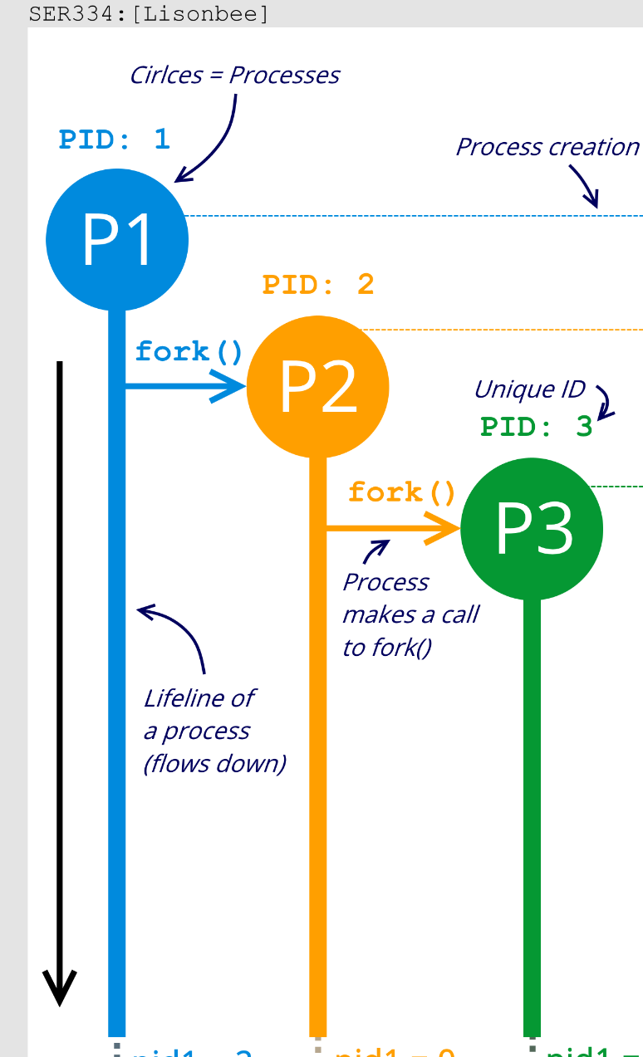
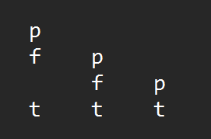
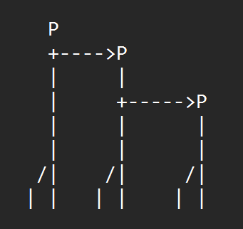
Any other suggestions or techniques for tracing during the exam?
SER 334
Execution Tracing Techniques
ASCII Diagram
p
fork | p
 | fork | p
thread | thread | thread

Slide 8
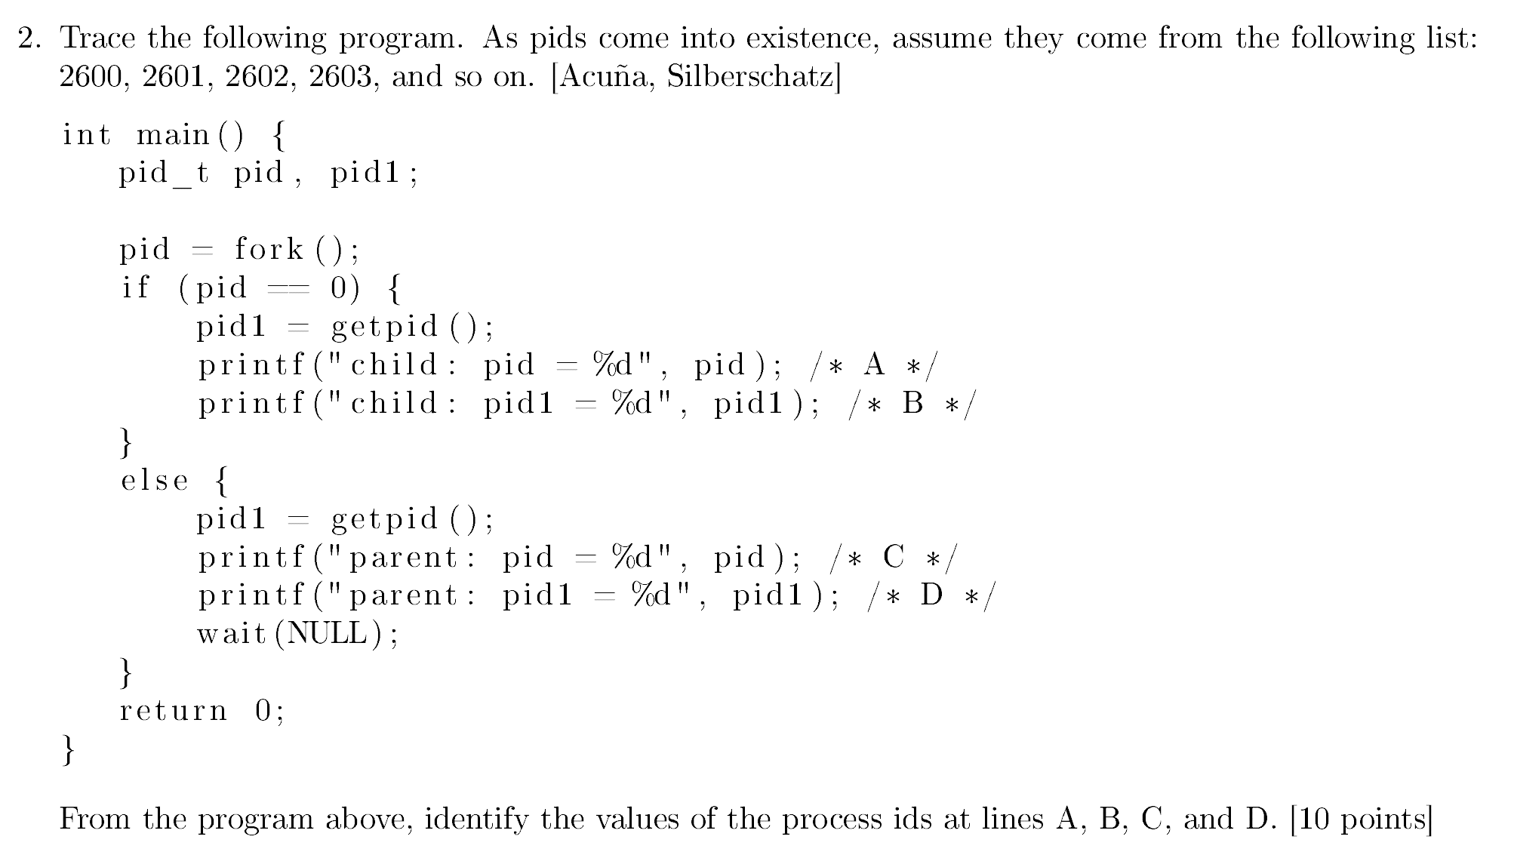
temp1
SER 334
P1
1502
temp2
Exam 2 Review
temp3
temp1
P2
1505
temp2
temp3

Slide 9
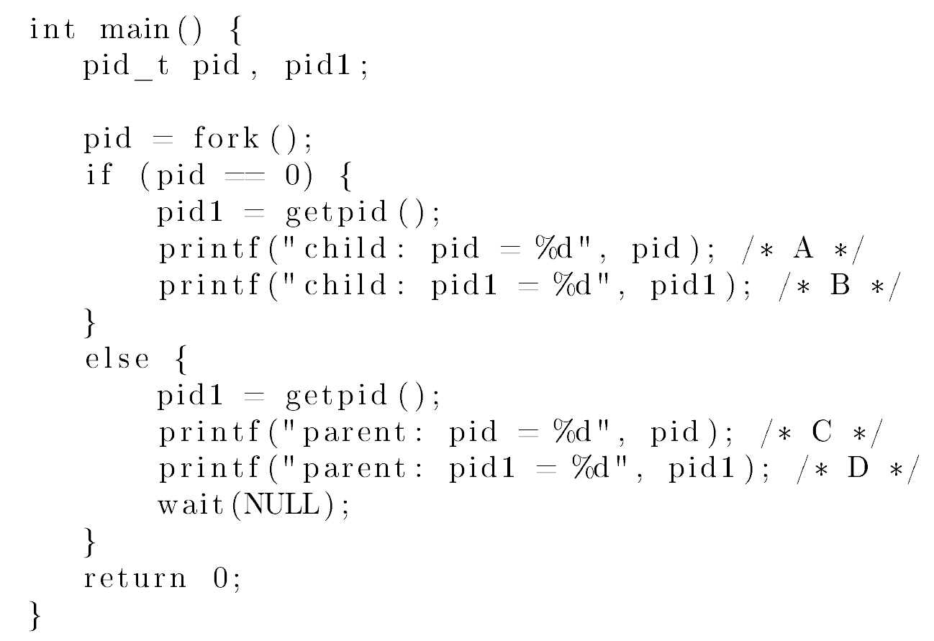
SER 334
Exam 2 Review
need

Slide 10
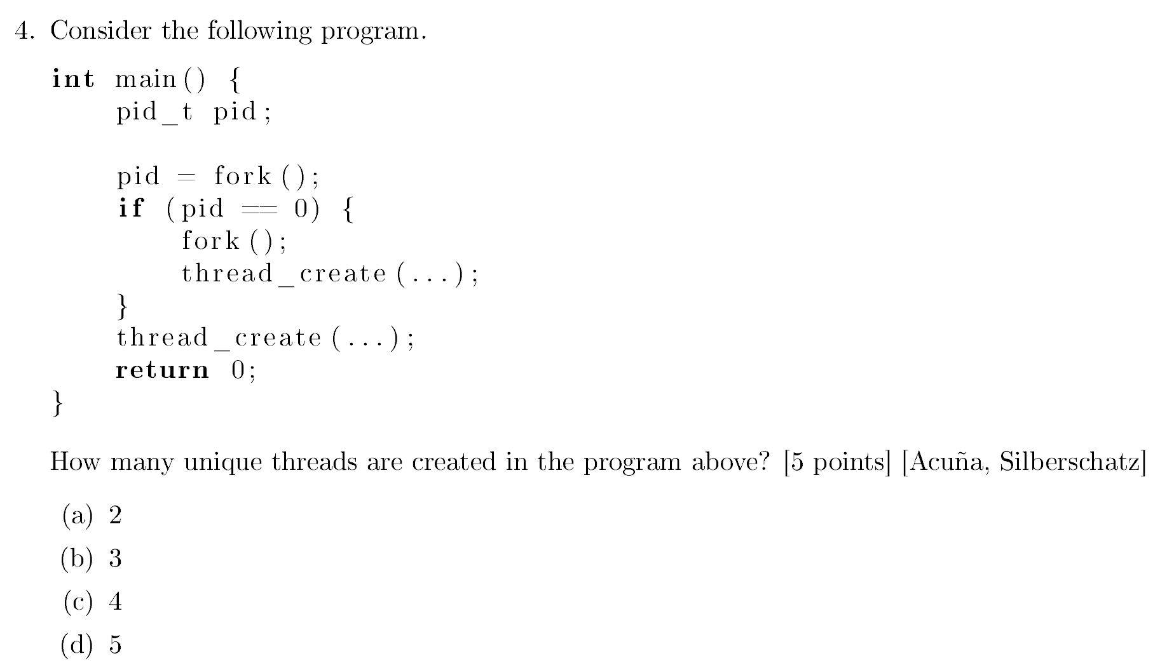
SER 334
Exam 2 Review

Slide 11
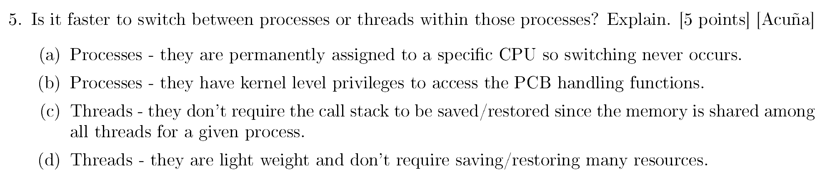
SER 334
Exam 2 Review

Slide 12
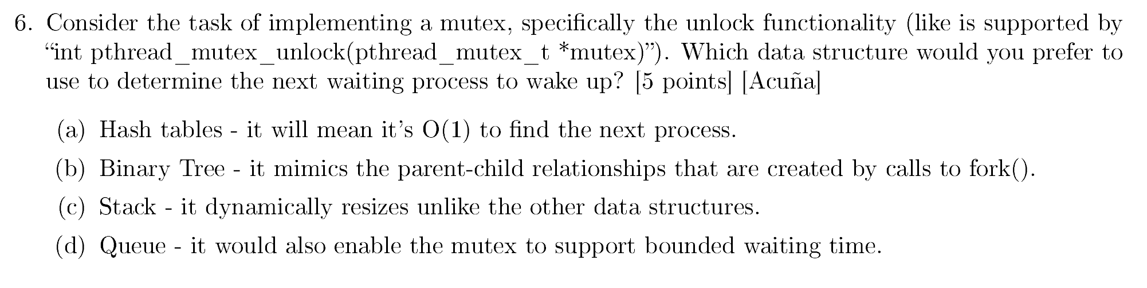
SER 334
Exam 2 Review

Slide 13
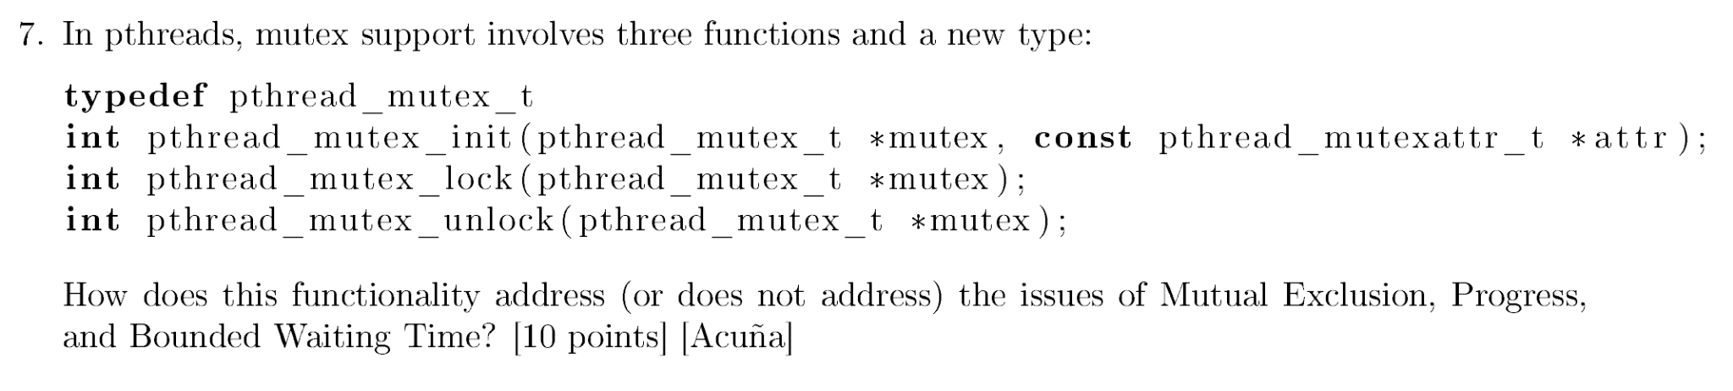
SER 334
Exam 2 Review

Slide 14
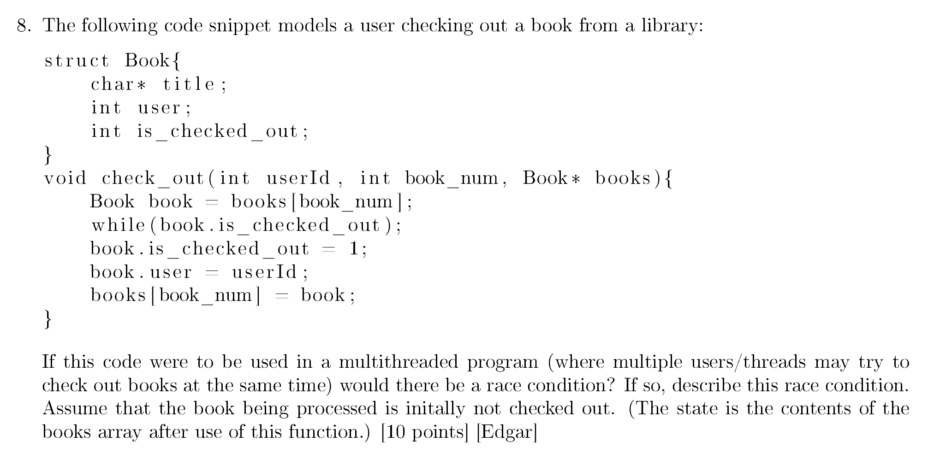
SER 334
Exam 2 Review

Slide 15
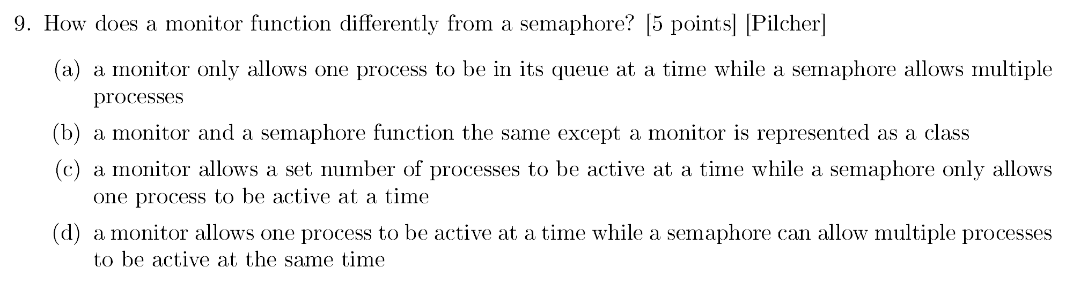
SER 334
Exam 2 Review

Slide 16
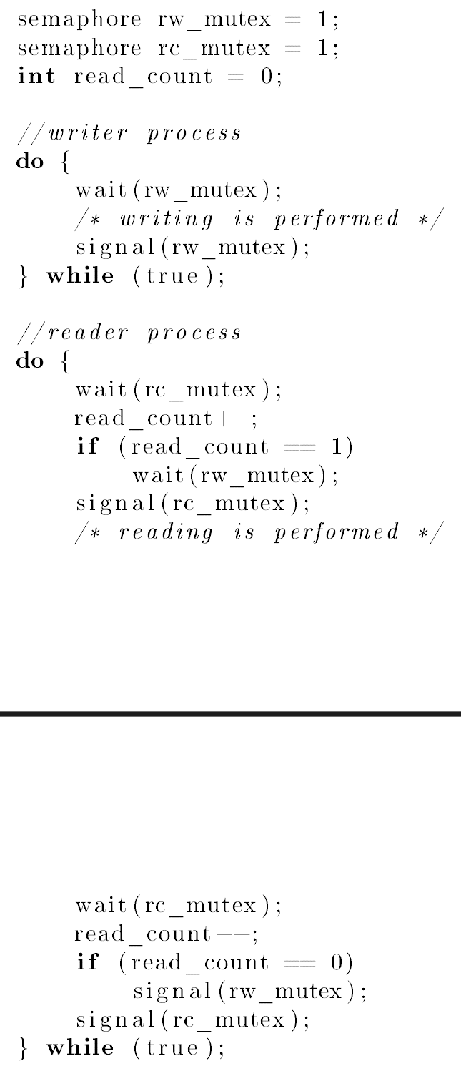
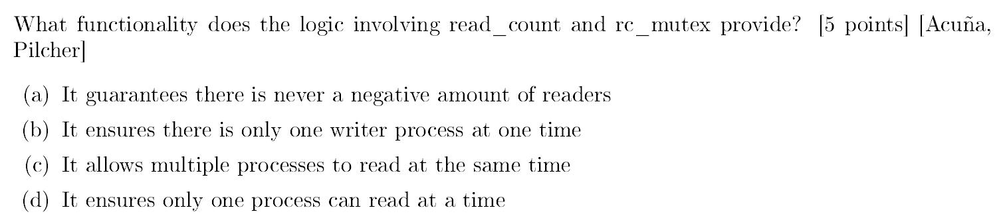
SER 334
Exam 2 Review

Slide 17
SER 334
Exam 2 Review
rw_mutex
read_count
#
rc_mutex

Slide 18
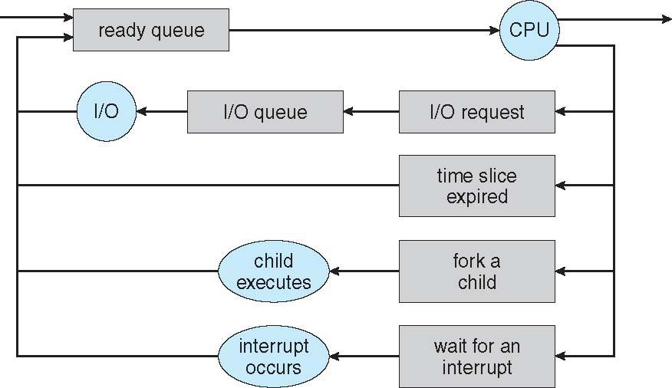
Module 5 Sample
3. [Bahremand] Explain why the queue diagram in slide 9 has a continuous cycle that flows between the listed queues and resources? Is a cycle necessary? [2 points]
SER 334
Exam 2 Review

Slide 19
Module 6 Sample
5. [Acuña] Consider the following program written with the pthreads library:
What is this programming trying to compute and how does it uses threads?
SER 334
Exam 2 Review
#include <pthread.h>
#include <stdio.h>
int t1, t2, input;
void* runner(void *param) {
int result, upper = (int)param;
int a = 1, b = 1, c = 1;
for (int i = 2; i < input-upper; i++) {
c = a + b;
a = b;
b = c;
}
if(upper == 1) {
t1 = c;
} else {
t2 = c;
}
pthread_exit(0);
}
int main(int argc, char *argv[]) {
pthread_t tid1, tid2;
pthread_attr_t attr;
input = 10;
pthread_attr_init(&attr);
pthread_create(&tid1, &attr, runner, 1);
pthread_create(&tid2, &attr, runner, 2);
pthread_join(tid1, NULL);
pthread_join(tid2, NULL);
printf("result = %d\n", t1+t2);
}

Slide 20
Module 7 Sample
SER 334
5. [Acuña] Consider the code for Peterson's Solution. Notice that part of the algorithm has been commented out. Explain how this changes it's functionality. Will it still solve the critical section problem? Explain.
Exam 2 Review
//shared memory
int turn = 0;
bool flag[2] = { false, false };
//for some process i
do {
flag[i] = true;
turn = j;
while (flag[j] /* && turn == j */);
//critical section
flag[i] = false;
//remainder section
} while (true);

Slide 21
Module 8 Sample
6. [Lisonbee] The bounded buffer problem is a result of producing and consuming work asynchronously at different and/or variable rates. Provided below is are the producer and consumer functions used by a program.
Assume that the producer and consumer are running in parallel. In order to solve the bounded buffer problem demonstrated here, the appropriate calls to wait and signal need to be added. Rewrite the above code using wait and signal and initialize the 3 semaphores to the appropriate values (Note: you must use all three semaphores at least once in your calls to wait and signal).
SER 334
Exam 2 Review
int data[15], i0 = 0, i1 = 0;
semaphore mutex = ... ;
semaphore empty = ... ;
semaphore full = ... ;
void producer() {
while (1) {
data[i0] = i0 * i0;
i0 = ++i0 % 15;
}
}
void consumer() {
while (1) {
printf("%d\n", data[i1]);
i1 = ++i1 % 15;
}
}

Slide 22
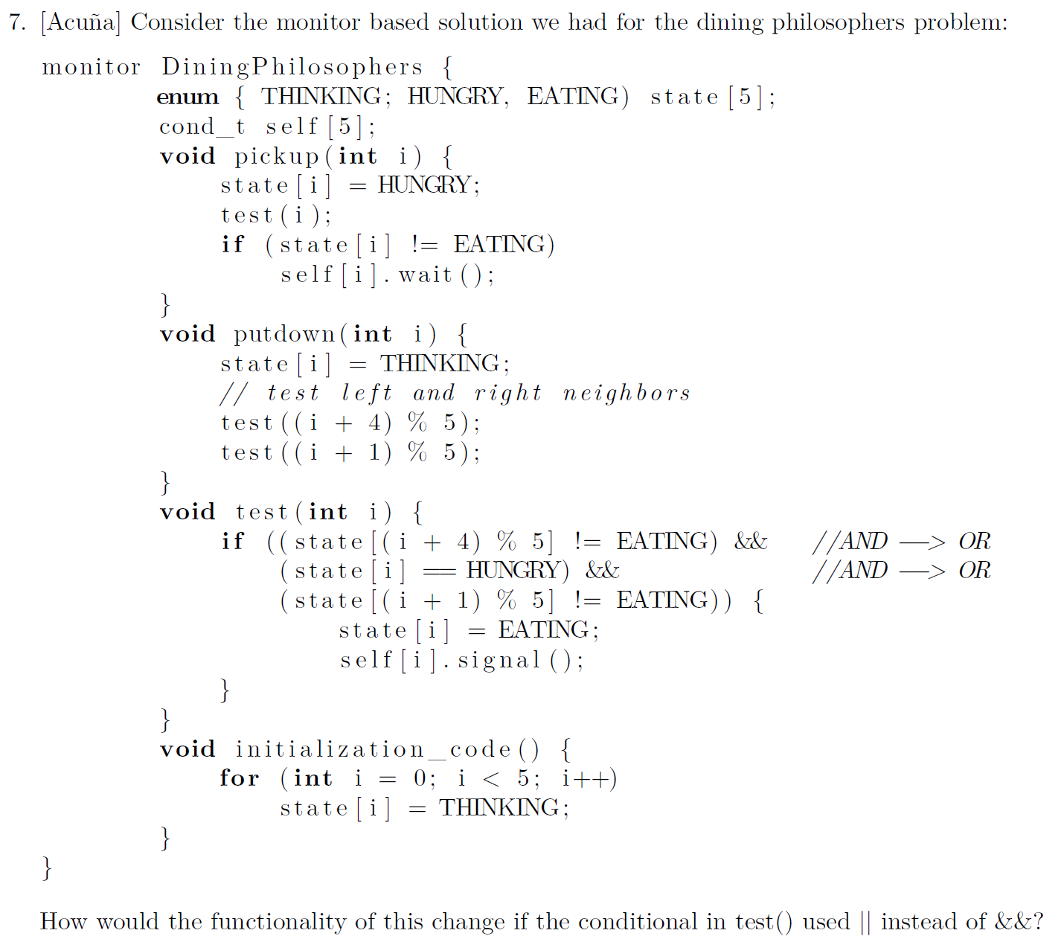
Module 8 Sample
SER 334
Exam 2 Review

Slide 23
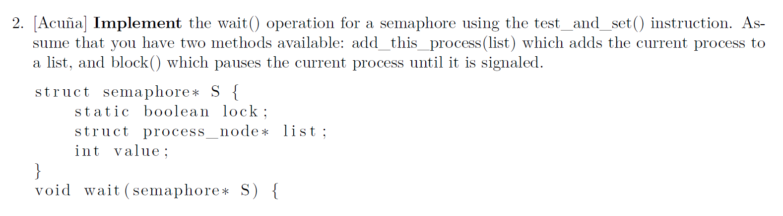
Module 8 Sample
SER 334
Exam 2 Review

Slide 24
SER 334
Exam 2 Review

Slide 25
SER 334
Scratch Space

Slide 26
Upcoming Events
SI Sessions:
Sunday, February 11th at 7:00 pm MST Cancelled - Good luck on Exam 2!
Monday, February 12th at 7:00 pm MST
Review Sessions:
Exam 3 Review: TBD
Good luck on the Exam
You got this!

Slide 27

Questions?
Survey:
http://bit.ly/ASN2324

Slide 28


More Questions?
Check out our other resources!
tutoring.asu.edu
1-
2-
Click on ‘Go to Zoom’ to log onto our Online Tutoring Center.
Click on ‘View the tutoring schedule’ to see when tutors are available for specific courses.

Slide 29
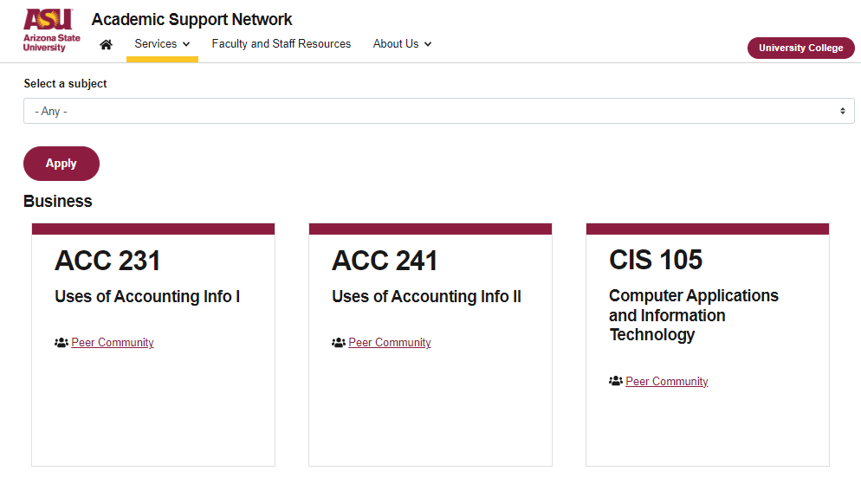

More Questions?
Check out our other resources!
tutoring.asu.edu/online-study-hub
Don’t forget to check out the Online Study Hub for additional resources!

Slide 30


Expanded Writing Support Available
Including Grammarly for Education, at no cost!
tutoring.asu.edu/expanded-writing-support
*Available slots for this pilot are limited

Slide 31
Additional Resources
Course Repo
Course Discord
BMP File Format (Wiki)
Linux Kernel API
Bootlin - Linux Cross Referencer
Dining Philosophers Interactive
Producer/Consumer Visual

